Slide 1

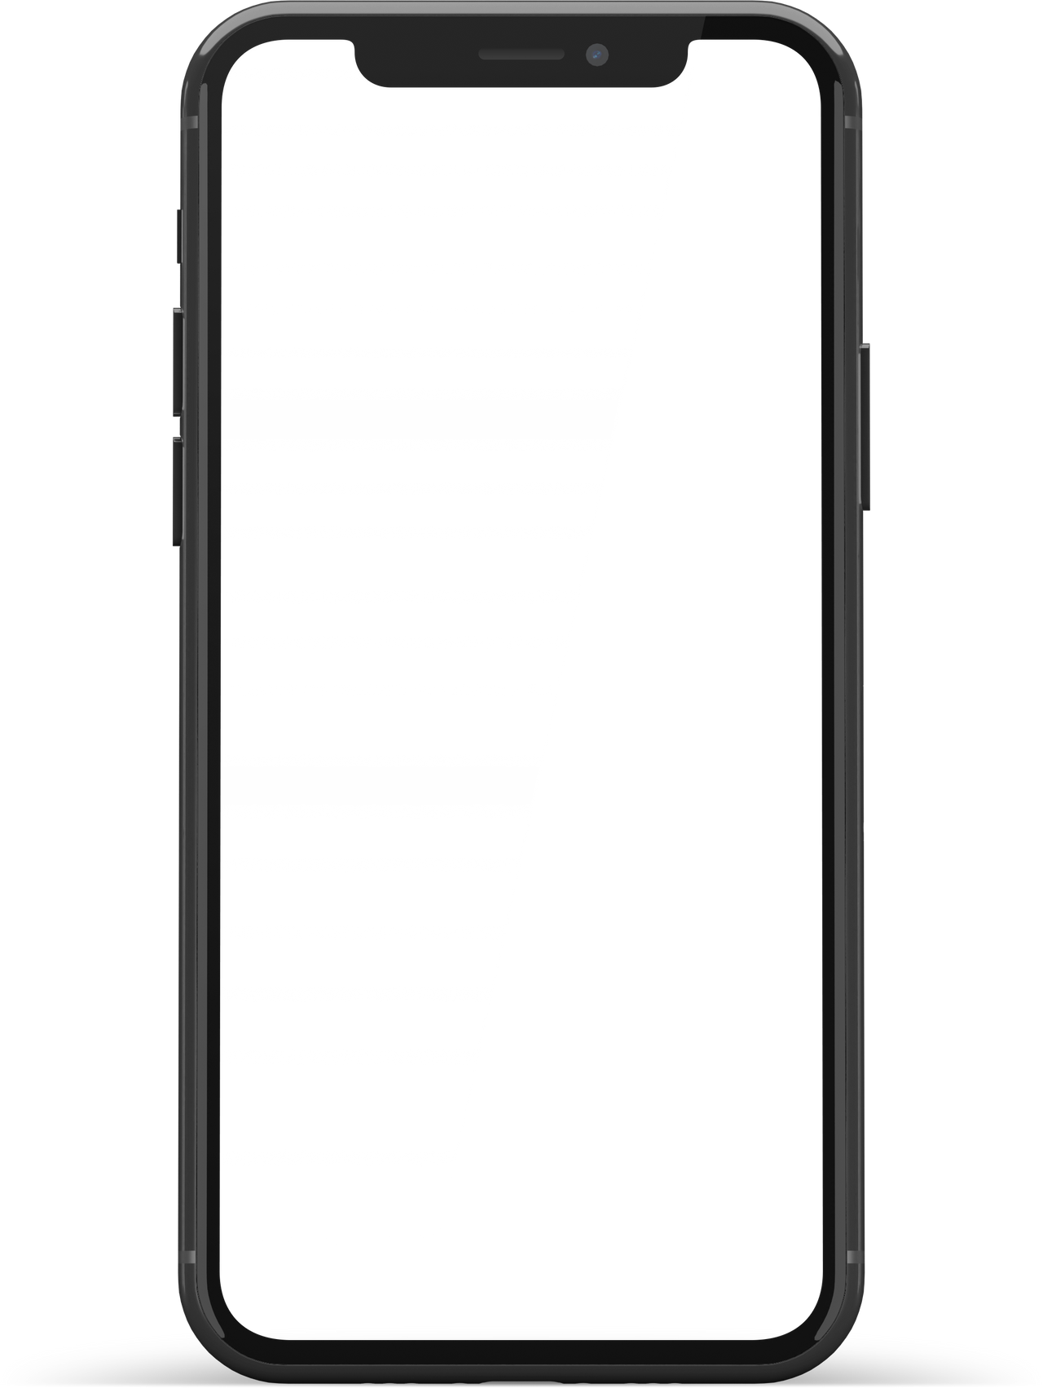
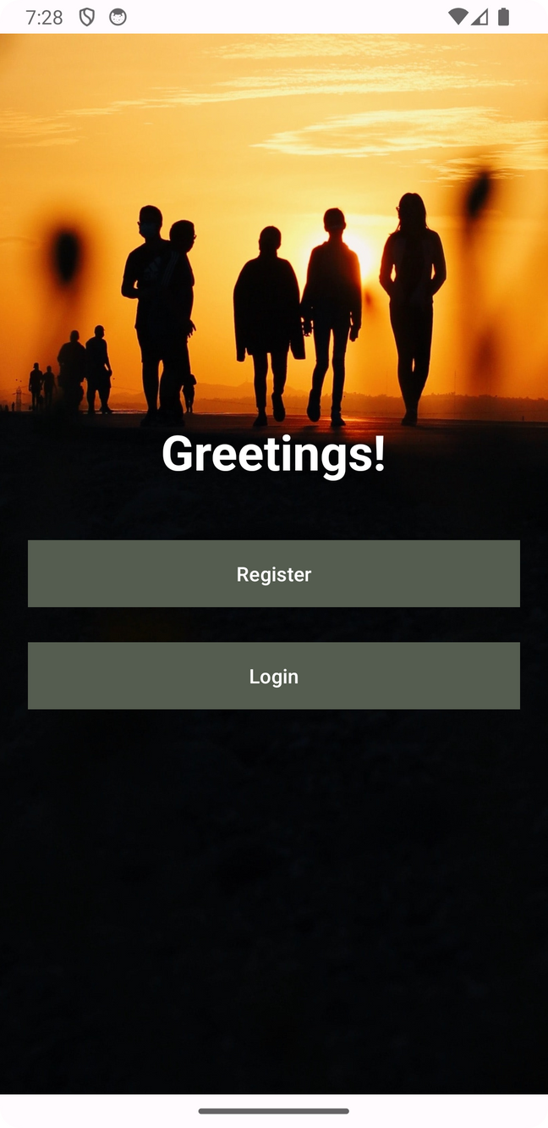
Texting
App
Presentation
Code Conversations, Firebase Fusion!
Aayush Raghvuanshi
Let's go →

Slide 2

Table of Contents
1
2
3
4
Introduction
Related Work
Project Structure, Design and Requirements
Demo
Motivation behind the development of this project.
A brief explaination of difference between Texting App and Telegram.
Explanation on Architecture, Structure and Design of the Texting App.
Quick overview, demonstration of functionality of the Texting App.

Slide 3


1
Introduction
Motivation behind the development of this project.
Press here →

Slide 4
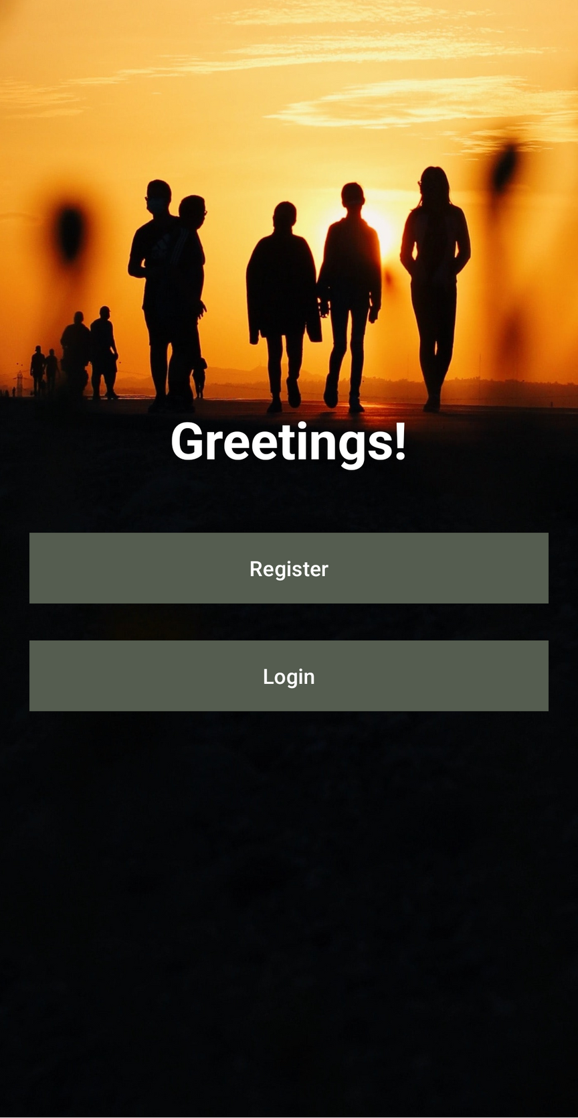

Platforms that enable deep human connections are more important than ever at a time of fast technical advancement and widespread internet access. Our app, Texting App, was created with the intention of bridging barriers, fostering relationships, and enabling users to participate in meaningful discussions. It is within this framework that it takes shape.
As developer of Texting App, we are committed to continuous improvement and innovation. We recognize the dynamic nature of user needs and strive to adapt our platform to cater to those needs effectively. Through user feedback, regular updates, and a passionate development team, we aim to evolve Texting App into a go-to platform for authentic, meaningful conversations.
Key Features:
Personalized Profiles: Users can create detailed profiles that reflect their personalities, interests, and aspirations, facilitating more meaningful connections.
Media Sharing: Texting App goes beyond text-based conversations, allowing users to share images, videos, and other media, enhancing the richness of their communication.
Security and Privacy: We prioritize user privacy and data security, implementing robust measures to ensure a safe and secure environment for all interactions.
Innovative Messaging: Texting app introduces innovative messaging features, empowering users to express themselves in creative ways and making conversations more engaging.
2023
Motivation

Slide 5
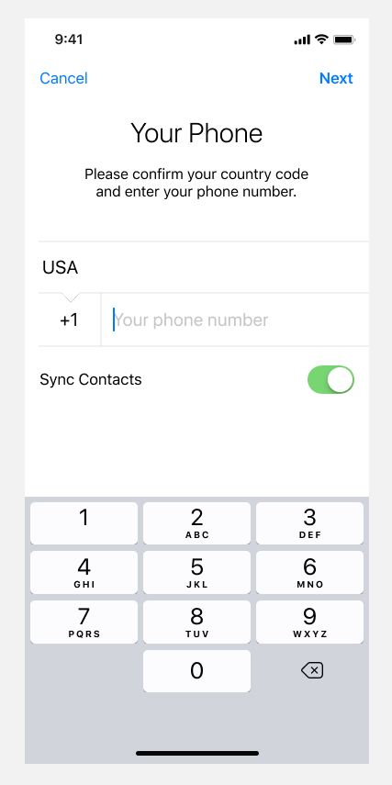

2
Related Work
Press here →
A brief explaination of difference between Texting App and Telegram.

Slide 6

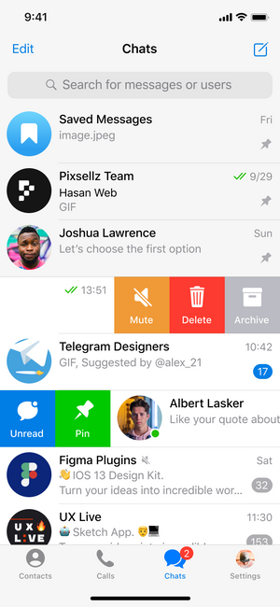
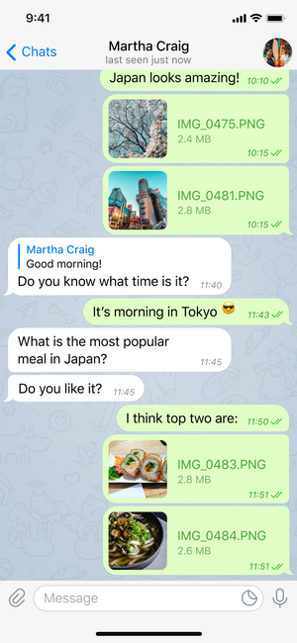
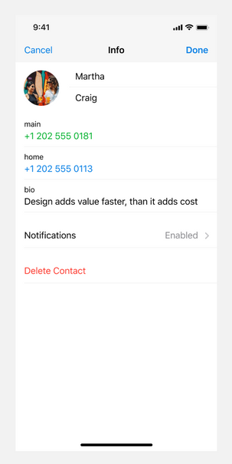
Related Work : Telegram and Texting App.
1
2
3
Telegram's chat list provides a comprehensive overview of ongoing conversations. It includes basic details such as contact names and last message timestamps. Users can initiate new chats, create groups, and access settings for each chat individually.
Telegram's chat screen is known for its simplicity and functionality. It supports text, media, and file sharing. Users can send voice messages, images, videos, and documents. The chat screen also features end-to-end encryption for enhanced privacy.
Telegram's account management involves basic user information, profile picture customization, and privacy settings. Users can adjust privacy options for their last seen status, profile photo visibility, and more.

Slide 7
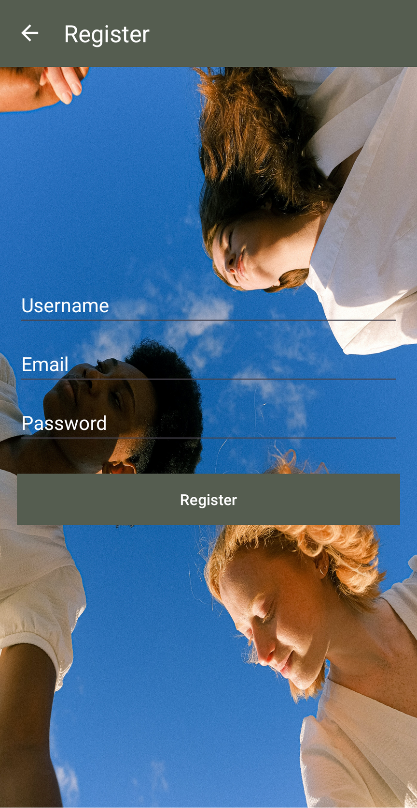
2
Project Structure, Design and Requirements
Explanation on Architecture, Structure and Design of the Texting App.

Slide 8


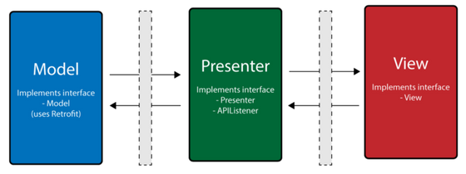
Model-View-Presenter (MVP)
The View component represents the user interface and presentation layer. It is responsible for displaying data to the user and capturing user input. Remains as passive as possible, avoiding direct dependencies on the Model.
The Presenter acts as an intermediary between the Model and the View. Handles user input, processes it, and updates the Model and View accordingly. Contains the application logic, making decisions based on user interactions.
The Model component encapsulates the data and business logic of Texting App.
It is responsible for data retrieval, manipulation, and storage.
Ensures data consistency and integrity.
Model
View
Presenter

Slide 9

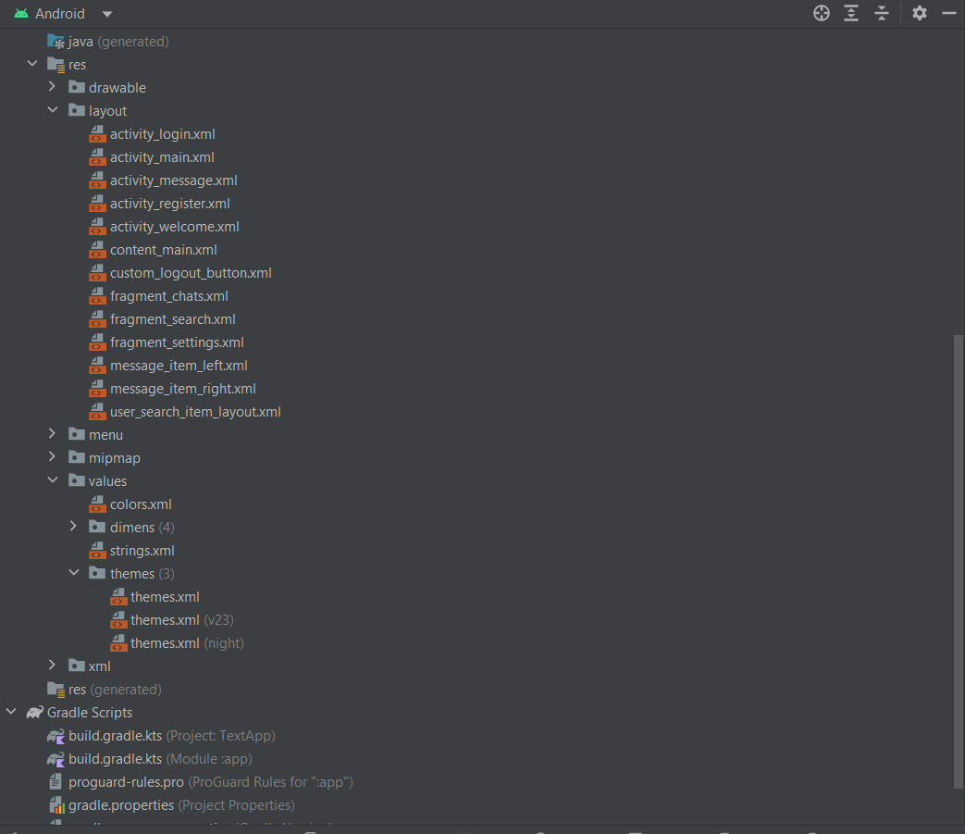
Structure
Model Classes (modelclasses package):
Chat.kt: Represents a chat message with attributes such as sender, message content, receiver, etc.
ChatList.kt: Represents a list of chats, possibly used for chat organization.
Users.kt: Represents user data, including UID, username, profile information, etc.
Activities:
LoginActivity.kt: Handles user login functionality using Firebase Authentication. Uses email and password for user login.
MainActivity.kt: Main activity that contains a TabLayout with three fragments: ChatsFragment, SearchFragment, and SettingsFragment. Handles user authentication, retrieves user data, and populates the Uwith user information. Manages the chat list and user profile display.
MessageActivity.kt: Manages individual chat conversations. Displays user information and chat messages. Supports sending text messages and images. Updates message status (seen/unseen) and retrieves messages from Firebase.
RegisterActivity.kt: Handles user registration using Firebase Authentication. Collects user details like username, email, and password. Creates a new user account in Firebase Realtime Database.
WelcomeActivity.kt: Landing page that directs users to login or register based on their authentication status.
Firebase Integration:
Firebase Authentication (mAuth): Used for user authentication (login and registration).
Firebase Realtime Database (refUsers): Stores and retrieves user-related data. Manages chat lists, individual chat messages, and user information.
Layouts: XML layout files (res/layout): Define the visual structure of activities and fragments. Include components like buttons, text fields, toolbars, and RecyclerViews.
Adapters (AdapterClasses package): ChatsAdapter.kt: Manages the display of chat messages in RecyclerView. Binds chat data to UI elements.

Slide 10
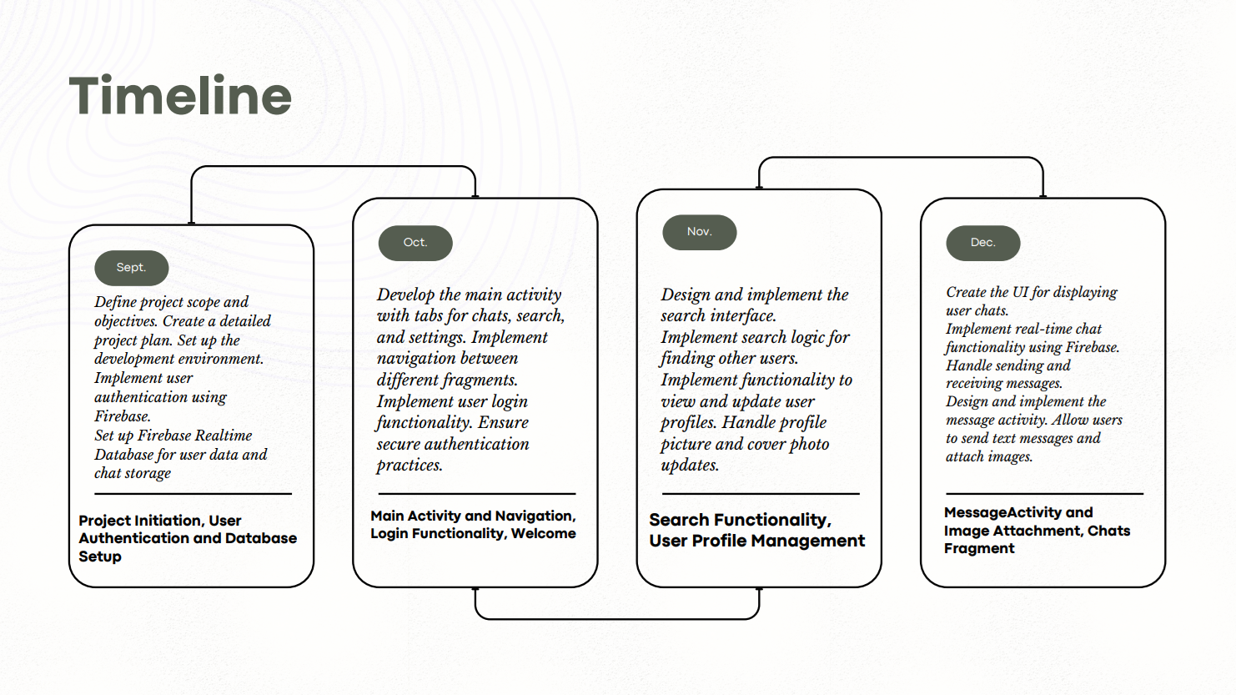

Slide 11
Greetings Screen!
Purpose:
Serves as the entry point for the application.
Allows users to navigate to the login or registration page based on their authentication status.
Components:
Two buttons (register_welcome_btn and login_welcome_btn) for navigating to the registration and login pages.
Functionality:
Redirects users to the RegisterActivity if they choose to register.
Redirects users to the LoginActivity if they choose to log in.
If a user is already authenticated (FirebaseUser is not null), redirects them to the MainActivity.
2023
September

Slide 12
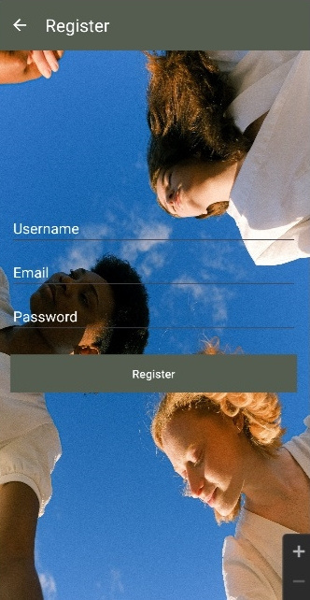
Register Screen
Purpose:
Allows users to create a new account by providing a username, email, and password.
Components:
username_register, email_register, and password_register: EditText for entering username, email, and password.
register_btn: Button for initiating the registration process.
Functionality:
Registers a new user using Firebase Authentication.
Creates a new user entry in the Firebase Realtime Database with initial profile information.
Upon successful registration, redirects the user to the MainActivity.
2023
September

Slide 13
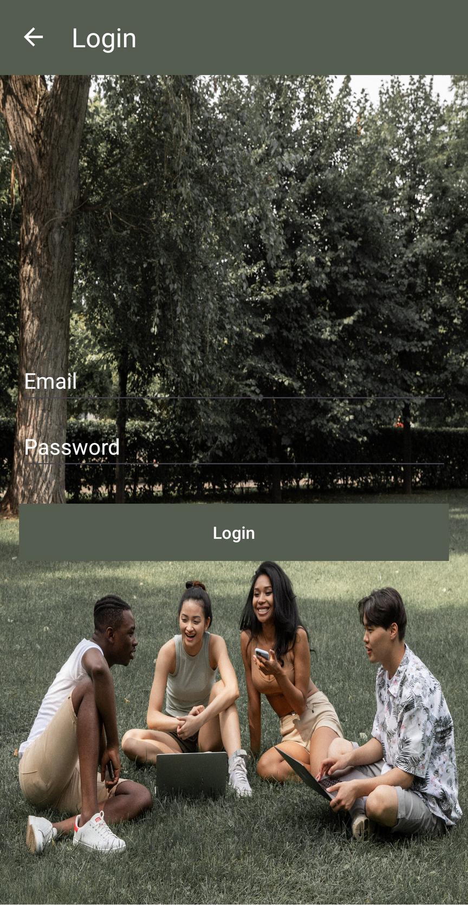
Login Screen
Purpose:
Allows users to log in to the application using their email and password.
Components:
email_login and password_login: EditText fields for entering email and password.
login_btn: Button for initiating the login process.
Functionality:
Logs in the user using Firebase Authentication.
If successful, redirects the user to the MainActivity.
Handles cases where login fails and provides appropriate error messages.
2023
October

Slide 14

Main Screen
MainActivity:
Purpose:
Main screen of the application, featuring a TabLayout with three tabs: Chats, Search, and Settings.
Components:
TabLayout and ViewPager: For organizing and displaying the three main fragments.
toolbar_main: Toolbar for the main activity.
Functionality:
Manages user authentication and retrieves user information from Firebase.
Displays user details, including username and profile picture.
Contains three fragments:
ChatsFragment: Displays the list of chats.
SearchFragment: Allows users to search for other users.
SettingsFragment: Provides account settings and logout functionality.
Implements a ViewPagerAdapter to handle fragment navigation.
2023
October

Slide 15

Search Fragments
Purpose:
Displays a list of chat conversations.
Components:
RecyclerView: Displays individual chat items.
ChatsAdapter: Manages the chat item layout and data binding.
Functionality:
Retrieves and displays chat data from Firebase Realtime Database.
Handles item clicks to open individual chat screens (MessageActivity).
2023
November

Slide 16
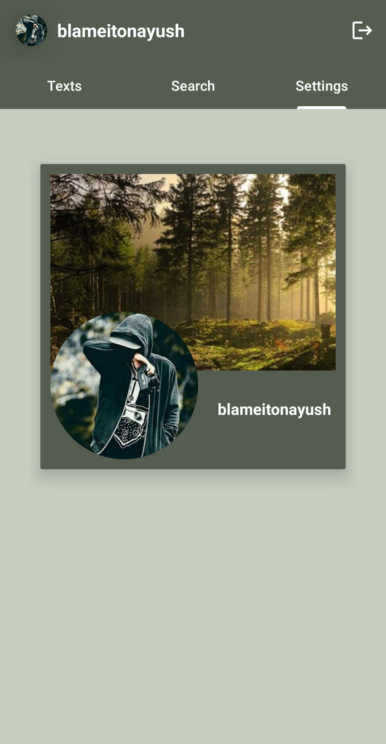
Settings Fragments
Purpose:
Provides user account settings and options.
Components:
Various UI elements for displaying and updating user settings.
CircleImageView for displaying the user's profile picture.
TextViews for username and status display.
Buttons for actions like changing profile picture, updating status, and logging out.
Functionality:
Retrieves and displays the current user's information, including username and profile picture.
Allows users to change their profile picture by selecting a new image.
Enables users to update their status.
Provides options for navigating to external links (Facebook, Instagram, Website).
Implements a logout button that logs the user out of the application.
Ensures proper user authentication and security measures for account management.
2023
November

Slide 17
Texts Fragments
Purpose:
Displays a list of chat conversations.
Components:
RecyclerView: Displays individual chat items.
ChatsAdapter: Manages the chat item layout and data binding.
Functionality:
Retrieves and displays chat data from Firebase Realtime Database.
Handles item clicks to open individual chat screens (MessageActivity).
2023
November

Slide 18
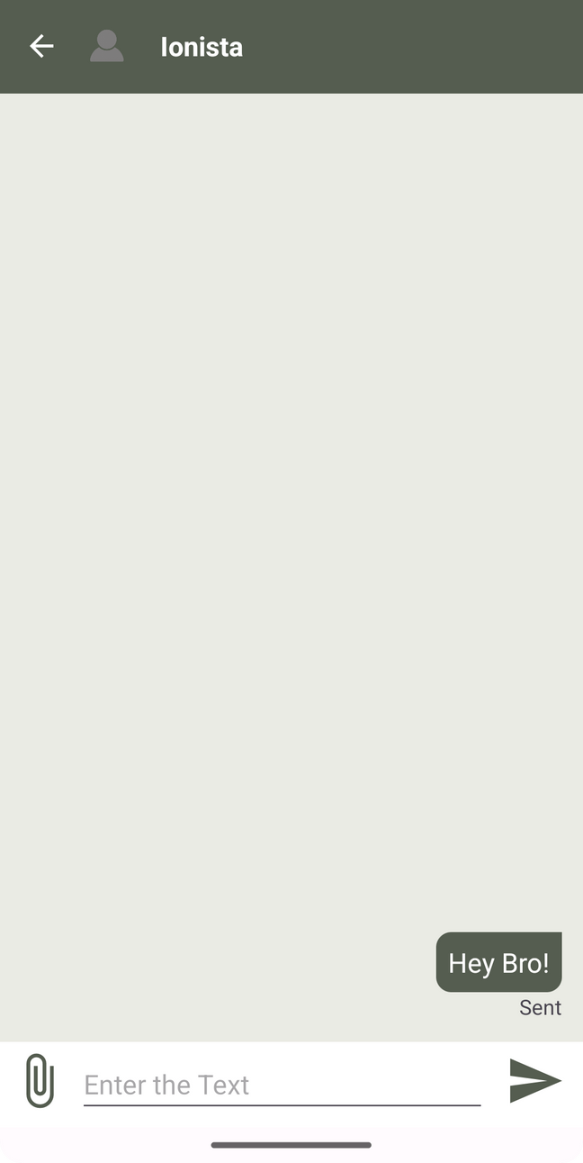
Messaging Screen
Purpose:
Manages individual chat conversations.
Components:
RecyclerView: Displays individual chat messages.
EditText and ImageView: Allows users to type and send messages.
ChatsAdapter: Manages the chat message item layout and data binding.
Functionality:
Retrieves and displays chat messages for the selected user.
Allows users to send text messages and images.
Updates the status of messages (seen/unseen).
Manages the attachment of image files.
2023
November

Slide 19
Conclusion
In conclusion, Android application appears to be a messaging platform with user authentication, chat functionalities, and user account management. Here's a summary of key aspects:
Authentication:
Utilizes Firebase Authentication for user registration and login.
Maintains user sessions securely, allowing a seamless transition between activities.
User Interface:
Features a welcome screen with options for user registration and login.
Employs a user-friendly layout with toolbars for navigation across different activities.
Main Activity:
Implements a tab-based interface using TabLayout and ViewPager.
Contains fragments for displaying chats, searching for users, and managing user settings.
Retrieves and displays user information dynamically, including profile pictures.
Chat Functionality:
Allows users to send and receive text messages.
Supports the sending and receiving of images within chats.
Implements real-time updates for seen messages.
User Search:
Integrates a search functionality for finding other users.
Displays search results in a RecyclerView with user details.
Facilitates the initiation of chats with selected users.
Settings:
Provides a settings fragment for managing user account details.
Enables users to change profile pictures, update status, and view external links.
Implements a logout option for secure session termination.
Firebase Integration:
Interacts with the Firebase Realtime Database for storing and retrieving user data.
Utilizes Firebase Storage for handling user profile pictures.
Project Structure:
Maintains a structured project organization with packages for model classes, adapters, and activities.

Slide 20
Thank You!

